Slide 1
Short Message Service
Lecturer: Ngo Huy Bien
Software Engineering Department
Faculty of Information Technology
VNUHCM - University of Science
Ho Chi Minh City, Vietnam
nhbien@fit.hcmus.edu.vn

Slide 2

Objectives

Slide 3

Contents

Slide 4

References
https://www.developershome.com/sms/

Slide 5
SMS (Short Message Service)
One SMS message can contain at most 140 bytes (1120 bits) of data.
SMS text messaging supports languages internationally.
SMS messages can also carry binary data.
SMS is supported by 100% GSM (Global System for Mobile Communications) mobile phones.

Slide 6
EMS (Enhanced Messaging Service)
It is an application-level extension of SMS.
An EMS message can include rich-media content such as pictures, animations and melodies.
It is less widely supported than SMS on wireless devices.

Slide 7
Applications of SMS Messaging
Person-to-person text messaging
Provision of information to mobile users
Downloading
Alerts and notifications
SMS marketing

Slide 8
SMS Center (SMSC)
An SMS center is responsible for handling the SMS operations of a wireless network.
SMSC address is an ordinary phone number in the international format.
SMSC address is pre-set in the SIM card by the wireless network operator.

Slide 9
SMS Gateway
The SMS gateway acts as a relay between the two SMSCs. It translates one SMSC protocol to another one.
Free SMS Gateway Software: https://www.kannel.org/

Slide 10
How to Forward a Text Message to Email
Certain phone services offer the ability to forward a text to an email account.
Forwarding texts to email is a reliable way of gaining access to multiple phone numbers while on the go.
If you need to leave one or more of your devices at home, for instance, you can still count on receiving text updates via email.
https://www.openphone.com/pricing

Slide 11
1. Register a Google Voice Virtual Number
https://voice.google.com/about

Slide 12
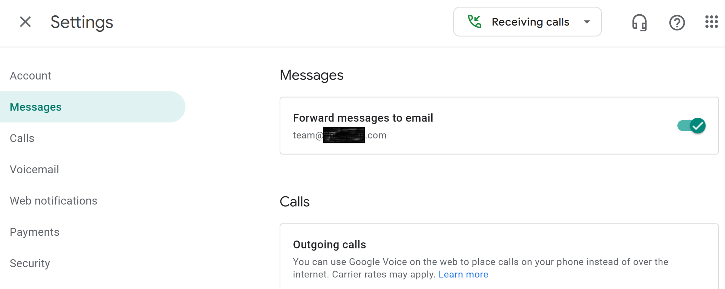
2. Forward SMS Messages to Email
https://voice.google.com/u/0/settings#messaging

Slide 13

Further Reading

Slide 14

Thank You & See You Again

